Slide 1
Algorithm Analysis
CS 330 Intro to the Design and Analysis of Algorithms
Lecture note
Dr. Sajedul Talukder

Slide 2
Algorithm Analysis
Given a non-empty array of integers nums, every element appears twice except for one. Find that single one.
int singleNumber(vector<int>& nums)
{
sort(nums.begin(), nums.end());
int i=0;
int n=nums.size();
while(i<n-1)
{
if(nums[i]==nums[i+1])
i=i+2;
else
return nums[i];
}
return nums[n-1];
}

Slide 3
Algorithm Analysis
Given a non-empty array of integers nums, every element appears twice except for one. Find that single one.
int singleNumber(vector<int>& nums)
{
sort(nums.begin(), nums.end());
int i=0;
int n=nums.size();
while(i<n-1)
{
if(nums[i]==nums[i+1])
i=i+2;
else
return nums[i];
}
return nums[n-1];
}
int singleNumber(vector<int>& nums)
{
int unique = 0;
for(int val: nums)
{
unique = (unique ^ val);
}
return unique;
}

Slide 4
Algorithm Analysis
We know:
  Experimental approach – problems
  Low level analysis – count operations
Abstract even further
Characterize an algorithm as a function of the “problem size”
E.g.
  Input data = array → problem size is N (length of array)
  Input data = matrix → problem size is N x M

Slide 5

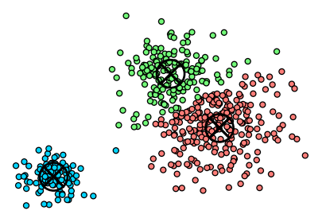
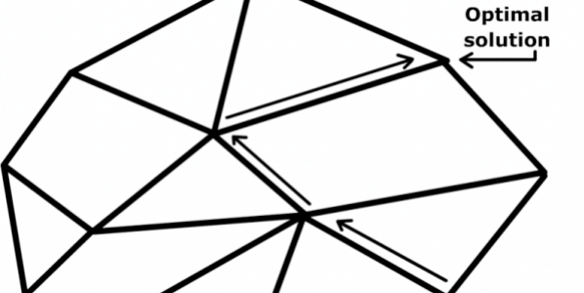
Worst-case analysis
Worst case. Running time guarantee for any input of size n.
  Generally captures efficiency in practice.
  Draconian view, but hard to find effective alternative.
Exceptions. Some exponential-time algorithms are used widely in practice because the worst-case instances don’t arise.
simplex algorithm
Linux grep
k-means algorithm
Notes:
http://blog.mpacula.com/2011/04/27/k-means-clustering-example-python/

Slide 6

Other types of analyses
Probabilistic. Expected running time of a randomized algorithm.
Ex. The expected number of compares to quicksort n elements is ~ 2n ln n.
Amortized. Worst-case running time for any sequence of n operations.
Ex. Starting from an empty stack, any sequence of n push and pop operations takes O(n) primitive computational steps using a resizing array.
Also. Average-case analysis, smoothed analysis, competitive analysis, ...
Notes:
https://www.interviewcake.com/concept/java/dynamic-array-amortized-analysis

Slide 7
Asymptotic Complexity
Running time of an algorithm as a function of input size n for large n.
Reveals deeper mathematical truths about algorithms that are independent of hardware.
Expressed using only the highest-order term in the expression for the exact running time.
  Instead of exact running time, say Θ(n²).
Describes behavior of function in the limit.
Written using Asymptotic Notation.

Slide 8
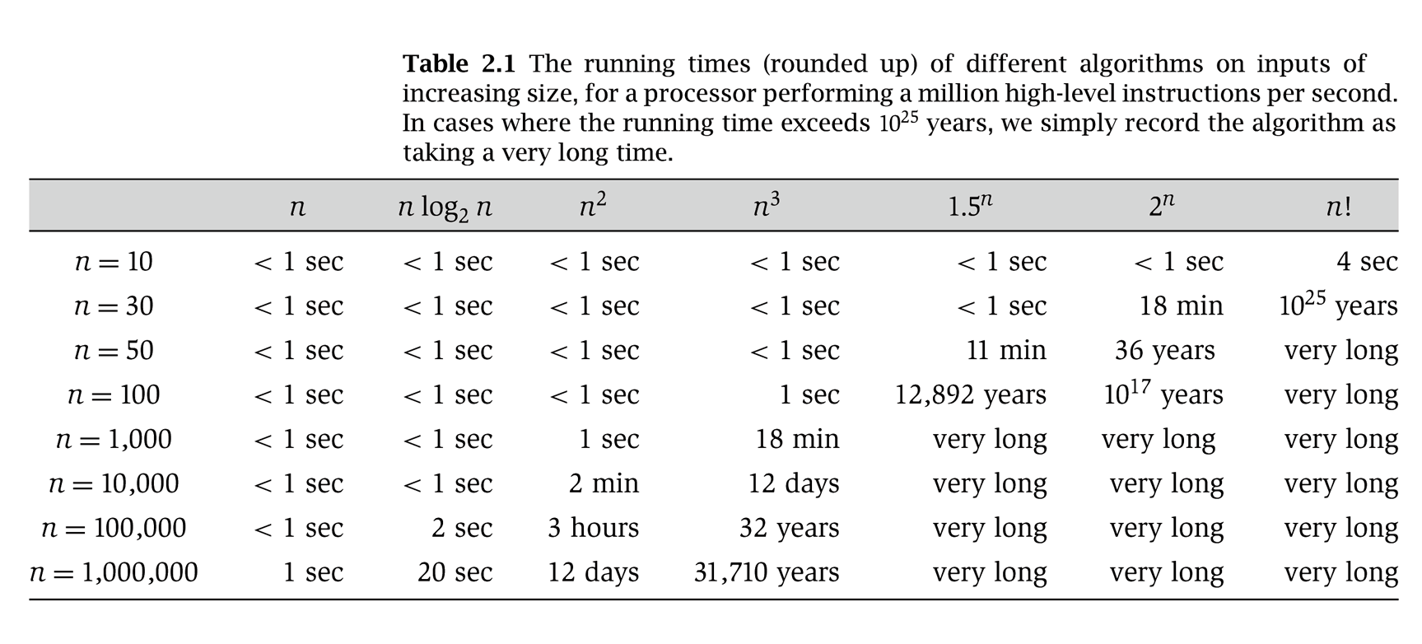
Why it matters

Slide 9
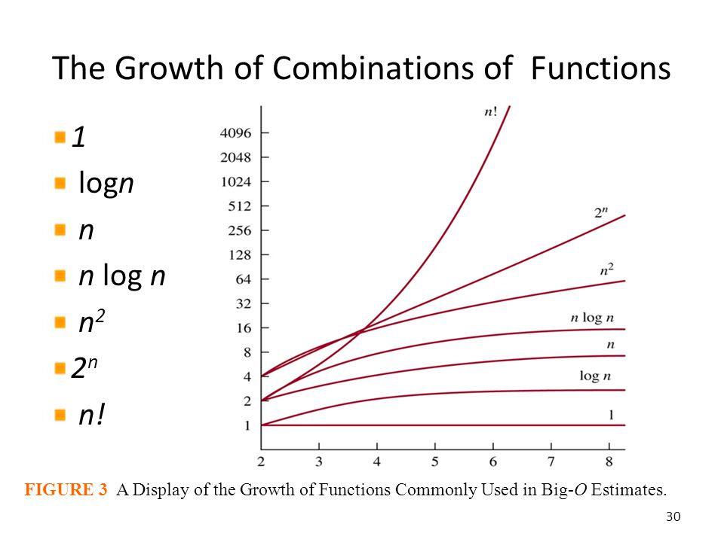
Asymptotic Notation
The notations describe different rate-of-growth relations between the defining function and the defined set of functions.

Slide 10
Asymptotic Notation
Θ, O, Ω, o, ω
Defined for functions over the natural numbers.
  Ex: f(n) = Θ(n²).
  Describes how f(n) grows in comparison to n.
Define a set of functions; in practice used to compare two function sizes.
The notations describe different rate-of-growth relations between the defining function and the defined set of functions.

Slide 11
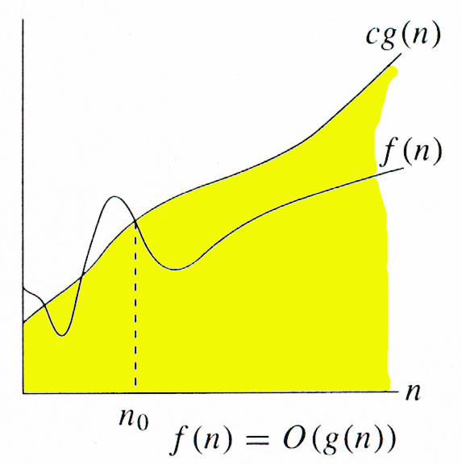
Big Oh notation
For function g(n), we define O(g(n)), big-O of n, as the set:
O(g(n)) = {f(n) :
∃ positive constants c and n_{0,} such that ∀n ≥ n₀,
we have 0 ≤ f(n) ≤ cg(n) }
Intuitively: Set of all functions whose rate of growth is the same as or lower than that of g(n).
g(n) is an asymptotic upper bound for f(n).
f(n) = Θ(g(n)) ⇒ f(n) = O(g(n)).
Θ(g(n)) ⊂ O(g(n)).

Slide 12
O notation
Upper bounds. f(n) is O(g(n)) if there exist constants c > 0 and n₀ ≥ 0
such that 0 ≤ f(n) ≤ c · g(n) for all n ≥ n₀.
Ex. f(n) = 32n² + 17n + 1.
  f(n) is O(n²).
  f(n) is neither O(n) nor O(n log n).
Typical usage. Insertion sort makes O(n²) compares to sort n elements.
c · g(n)
f(n)
choose c = 50, n0 = 1
n0
n
Notes:
In other words, beginning from n0, f(n) is not significantly larger than g(n).
By “significantly larger”, we mean a constant factor larger.
[wayne s18] some authors allow f(n) to be negative and use |f(n)| in definition, including COS 340 book

Slide 13
Big-Oh and Growth Rate
The big-Oh notation gives an upper bound on the growth rate of a function.
The statement “f(n) is O(g(n))” means that the growth rate of f(n) is no more than the growth rate of g(n).
We can use the big-Oh notation to rank functions according to their growth rate.
 | f(n) is O(g(n)) | g(n) is O(f(n))
g(n) grows faster | Yes | No
f(n) grows faster | No | Yes
Same growth | Yes | Yes

Slide 14
Big-Oh Rules
If is f(n) a polynomial of degree d, then f(n) is O(n^{d}), i.e.,
  Drop lower-order terms
  Drop constant factors
Use the smallest possible class of functions
  Say “2n is O(n)” instead of “2n is O(n²)”
Use the simplest expression of the class
  Say “3n + 5 is O(n)” instead of “3n + 5 is O(3n)”

Slide 15
Analysis of algorithms: quiz 1
Let f(n) = 3n² + 17 n log2 n + 1000. Which of the following are true?
  f(n) is O(n²).
  f(n) is O(n³).
  Both A and B.
  Neither A nor B.

Slide 16
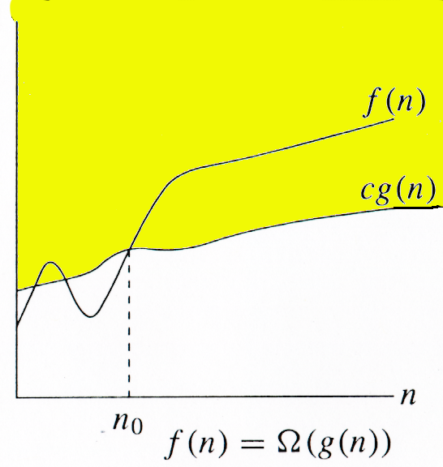
Big Omega notation
For function g(n), we define Ω(g(n)), big-Omega of n, as the set:
Ω(g(n)) = {f(n) :
∃ positive constants c and n_{0,} such that ∀n ≥ n₀,
we have 0 ≤ cg(n) ≤ f(n)}
Intuitively: Set of all functions whose rate of growth is the same as or higher than that of g(n).
g(n) is an asymptotic lower bound for f(n).
f(n) = Θ(g(n)) ⇒ f(n) = Ω(g(n)).
Θ(g(n)) ⊂ Ω(g(n)).

Slide 17
Ω -notation
Lower bounds. f(n) is Ω(g(n)) if there exist constants c > 0 and n₀ ≥ 0
such that f(n) ≥ c · g(n) ≥ 0 for all n ≥ n₀.
Ex. f(n) = 32n² + 17n + 1.
  f(n) is both Ω(n²) and Ω(n).
  f(n) is not Ω(n³).
Typical usage. Any compare-based sorting algorithm requires Ω(n log n) compares in the worst case.
Vacuous statement. Any compare-based sorting algorithm requires
at least O(n log n) compares in the worst case.
f(n)
choose c = 32, n0 = 1
c · g(n)
n0
n
Notes:
[wayne s18] suggest defining f is Omega(g) if g is O(f). Then do this definition on next slide as possible answer with either “for all” or “for infinitely many”
f is bounded below by g asymptotically
Statement doesn’t “type-check.”
Use Ω only lower bounds

Slide 18
Analysis of algorithms: quiz 2
Let f(n) = 3n² + 17 n log2 n + 1000. Which of the following are true?
  f(n) is Ω(n).
  f(n) is Ω(n²).
  Both A and B.
  Neither A nor B.

Slide 19
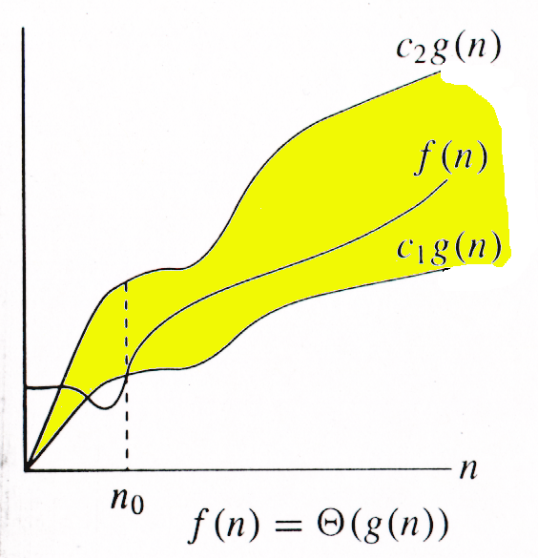
Big Theta notation
For function g(n), we define Θ(g(n)), big-Theta of n, as the set:
Θ(g(n)) = {f(n) :
∃ positive constants c₁, c₂, and n_{0,} such that ∀n ≥ n₀,
we have 0 ≤ c₁g(n) ≤ f(n) ≤ c₂g(n)
}
Intuitively: Set of all functions that
have the same rate of growth as g(n).
g(n) is an asymptotically tight bound for f(n).

Slide 20
Θ-notation
Tight bounds. f(n) is Θ(g(n)) if there exist constants c1 > 0, c2 > 0, and n₀ ≥ 0, such that 0 ≤ c1 · g(n) ≤ f(n) ≤ c2 · g(n) for all n ≥ n₀.
Ex. f(n) = 32n² + 17n + 1.
  f(n) is Θ(n²).
  f(n) is neither Θ(n) nor Θ(n³).
Typical usage. Mergesort makes Θ(n log n) compares to sort n elements.
c2 · g(n)
f(n)
c1 · g(n)
choose c1 = 32, c2 = 50, n0 = 1
n0
n
between ½ n log2 n
and n log2 n
Notes:
[wayne s18] define as f is Theta(g) if f is O(g) and Theta(g).

Slide 21
Analysis of algorithms: quiz 3
Let f(n) = 3n² + 17 n log2 n + 1000. Which of the following are true?
  f(n) is Θ(n).
  f(n) is Θ(n²).
  Both A and B.
  Only B.

Slide 22
Relations Between O, Ω, Θ

Slide 23
Relations Between Θ, Ω, O
Theorem : For any two functions g(n) and f(n),
f(n) = Θ(g(n)) iff
f(n) = O(g(n)) and f(n) = Ω(g(n)).
I.e., Θ(g(n)) = O(g(n)) ∩ Ω(g(n))
In practice, asymptotically tight bounds are obtained from asymptotic upper and lower bounds.

Slide 24
o-notation
For a given function g(n), the set little-o:
o(g(n)) = {f(n): ∀ c > 0, ∃ n₀ > 0 such that
∀ n ≥ n₀, we have 0 ≤ f(n) < cg(n)}.
f(n) becomes insignificant relative to g(n) as n approaches infinity:
lim [f(n) / g(n)] = 0
^{n→∞}
g(n) is an upper bound for f(n) that is not asymptotically tight.
Observe the difference in this definition from previous ones. Why?

Slide 25
ω -notation
For a given function g(n), the set little-omega:
ω(g(n)) = {f(n): ∀ c > 0, ∃ n₀ > 0 such that
∀ n ≥ n₀, we have 0 ≤ cg(n) < f(n)}.
f(n) becomes arbitrarily large relative to g(n) as n approaches infinity:
lim [f(n) / g(n)] = ∞.
^{n→∞}
g(n) is a lower bound for f(n) that is not asymptotically tight.

Slide 26
Asymptotic Notation in Equations
Can use asymptotic notation in equations to replace expressions containing lower-order terms.
For example,
  4n³ + 3n² + 2n + 1 = 4n³ + 3n² + Θ(n)
  = 4n³ + Θ(n²) = Θ(n³). How to interpret?
In equations, Θ(f(n)) always stands for an anonymous function g(n) ∈ Θ(f(n))
  In the example above, Θ(n²) stands for
  3n² + 2n + 1.

Slide 27
Asymptotic analysis - terminology
Special classes of algorithms:
  constant: O(1)
  logarithmic: O(log n)
  linear: O(n)
  quadratic: O(n²)
  polynomial: O(n^{k}), k ≥ 1
  exponential:O(a^{n}), n > 1
Polynomial vs. exponential ?
Logarithmic vs. polynomial ?
Graphical explanation?

Slide 28
Constant time
Constant time. Running time is O(1).
Examples.
  Conditional branch.
  Arithmetic/logic operation.
  Declare/initialize a variable.
  Follow a link in a linked list.
  Access element i in an array.
  Compare/exchange two elements in an array.
  …

Slide 29
Logarithmic time
Logarithmic time. Running time is O(log n).
Search in a sorted array. Given a sorted array A of n distinct integers and an integer x, find index of x in array.
O(log n) algorithm. Binary search.
  Invariant: If x is in the array, then x is in A[lo .. hi].
  After k iterations of while loop, (hi − lo + 1) ≤ n / 2^{k} ⇒ k ≤ 1 + log2 n.
remaining elements
lo ← 1; hi ← n.
While (lo ≤ hi)
  mid ← ⎣(lo + hi) / 2⎦.
  If (x < A[mid]) hi ← mid − 1.
  Else If (x > A[mid]) lo ← mid + 1.
  Else Return mid.
Return −1.
Notes:
after log_2 n iterations, there will be at most 1 element remaining. Still needs 1 iteration with 1 element remaining.

Slide 30
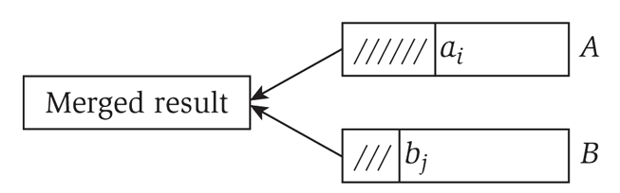
Linear time
Linear time. Running time is O(n).
Merge two sorted lists. Combine two sorted linked lists A = a₁, a₂, …, a_{n} and
B = b₁, b₂, …, b_{n} into a sorted whole.
O(n) algorithm. Merge in mergesort.
i ← 1; j ← 1.
While (both lists are nonempty)
  If (ai ≤ bj) append ai to output list and increment i.
  Else append bj to output list and increment j.
Append remaining elements from nonempty list to output list.
Notes:
Proof of running time: after each compare, the length of the output list increases by 1.

Slide 31
Quadratic time
Quadratic time. Running time is O(n²).
Closest pair of points. Given a list of n points in the plane (x₁, y₁), …, (x_{n}, y_{n}), find the pair that is closest to each other.
O(n²) algorithm. Enumerate all pairs of points (with i < j).
Remark. Ω(n²) seems inevitable, but this is just an illusion.
min ← ∞.
For i = 1 to n
  For j = i + 1 to n
    d ← (xi − xj)² + (yi − yj)².
    if (d < min)
      min ← d.

Slide 32
Cubic time
Cubic time. Running time is O(n³).
3-Sum. Given an array of n distinct integers, find three that sum to 0.
O(n³) algorithm. Enumerate all triples (with i < j < k).
Remark. Ω(n³) seems inevitable, but O(n²) is not hard.
For i = 1 to n
  For j = i + 1 to n
    For k = j + 1 to n
    If (ai + aj + ak = 0)
      Return (ai, aj, ak).

Slide 33
Polynomial time

Slide 34
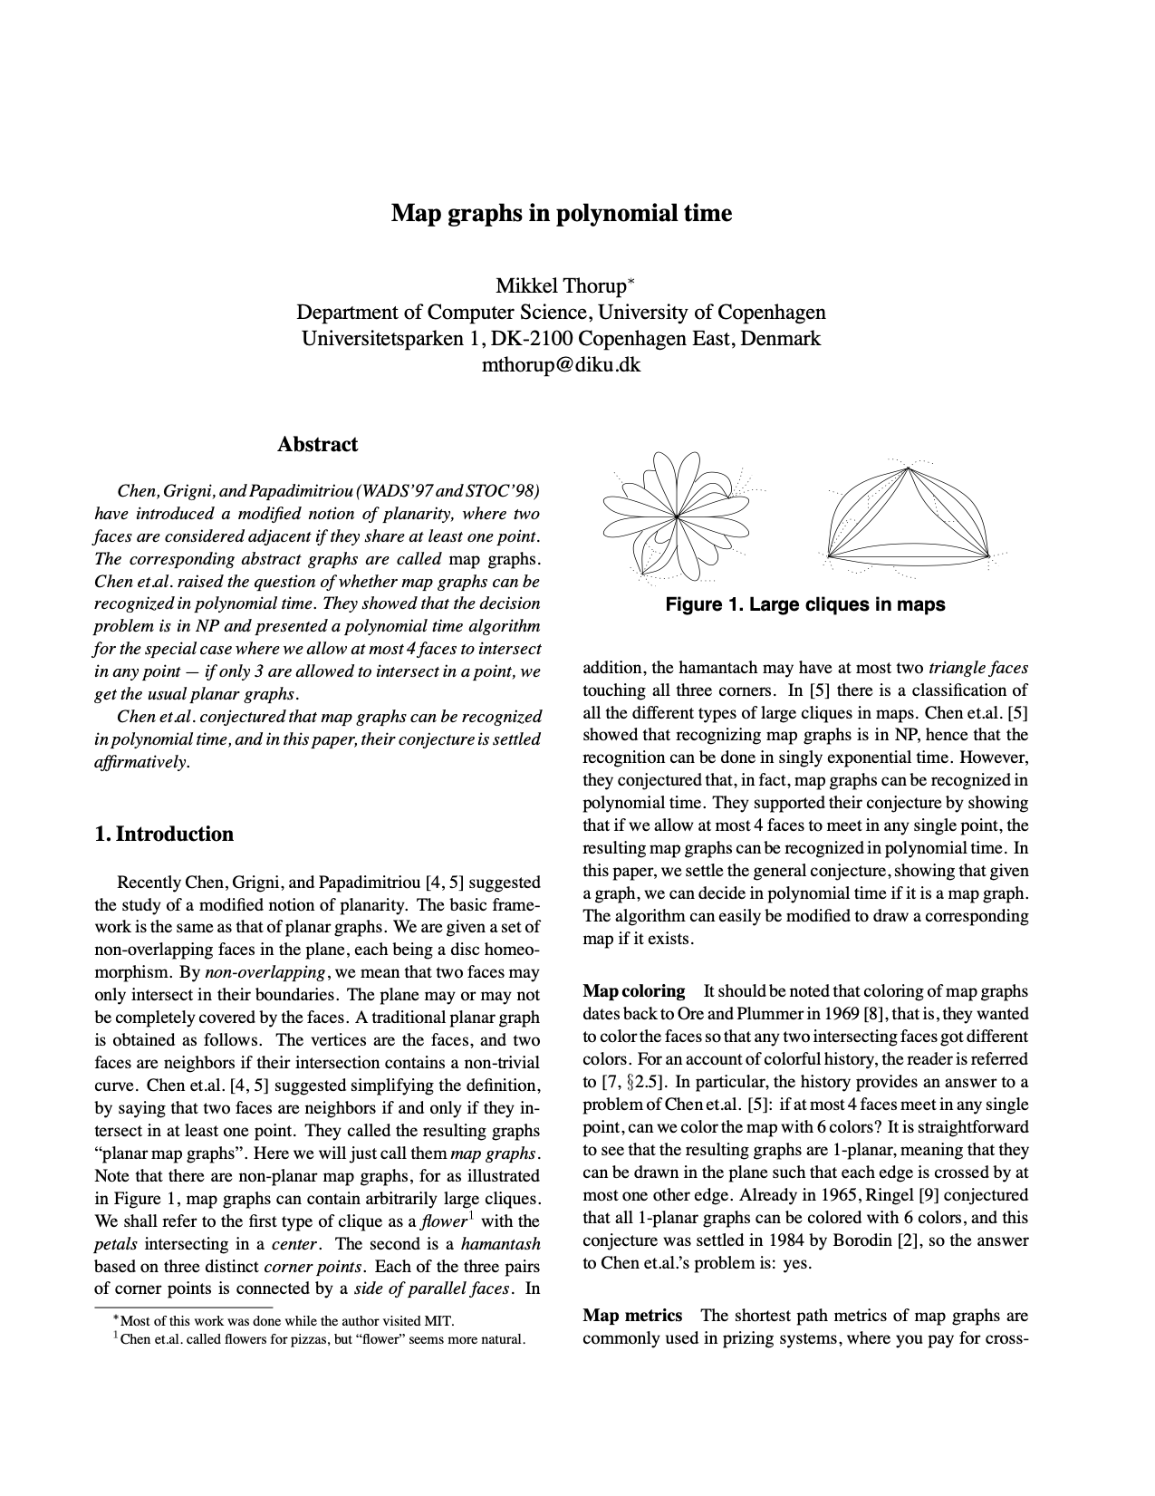
Polynomial running time
We say that an algorithm is efficient if it has a polynomial running time.
Theory. Definition is (relatively) insensitive to model of computation.
Practice. It really works!
  The poly-time algorithms that people develop have both
  small constants and small exponents.
  Breaking through the exponential barrier of brute force typically exposes some crucial structure of the problem.
Exceptions. Some poly-time algorithms in the wild
have galactic constants and/or huge exponents.
Q. Which would you prefer: 20 n¹²⁰ or n^{1 + 0.02 ln n} ?
n¹²⁰
Notes:
Paper: an algorithm (for recognizing map graphs, a generalization of planar graphs) with an n^120 algorithm.

Slide 35
Exponential time
Exponential time. Running time is O(2^{nk}) for some constant k > 0.
Independent set. Given a graph, find independent set of max cardinality.
O(n² 2^{n}) algorithm. Enumerate all subsets.
S* ← ∅.
Foreach subset S of nodes:
  Check whether S is an independent set.
  If (S is an independent set and ⎢S⎟ > ⎢S*⎟)
    S* ← S.
Return S*.

Slide 36
Prefix Averages (Linear)
The following algorithm computes prefix averages in linear time by keeping a running sum
Algorithm prefixAverages2(X, n)
Input array X of n integers
Output array A of prefix averages of X #operations
A ← new array of n integers n
s ← 0 1
for i ← 0 to n − 1 do n
s ← s + X[i] n
A[i] ← s / (i + 1) n
return A 1
Algorithm prefixAverages2 runs in O(n) time

Slide 37
Some Examples
Case 1: for (i=0; i<n; i++)
for (j=0; j<n; j++)
k++;
Case 2: for (i=0; i<n; i++)
k++;
for (i=0; i<n; i++)
for (j=0; j<n; j++)
k++;
Case 3: for (int i=0; i<n-1; i++)
for (int j=0; j<i; j++)
int k+=1;
O(n²)
O(n²)
O(n²)

Slide 38
Algorithm 1
int MaxSubSum1(const vector <int> & n) {
int maxSum=0;
for (int i=0; i<n.size(); i++)
for (int j=i; j<n.size(); j++) {
int thisSum=0;
for (int k=i; k<=j; k++)
thisSum+=n[k];
if (thisSum>maxSum)
maxSum=thisSum;
}
return maxSum;
}
O(n³)

Slide 39
Algorithm 2
int MaxSubSum2(const vector <int> & n) {
int maxSum=0;
for (int i=0; i<n.size(); i++) {
thisSum=0;
for (int j=i; j<n.size(); j++) {
thisSum+=n[j];
if (thisSum>maxSum)
maxSum=thisSum;
}
}
return maxSum;
}
O(n²)

Slide 40
Algorithm 3
int MaxSubSum4(const vector <int> & n) {
int maxSum=0, thisSum=0;
for (int j=0; j<n.size(); j++) {
thisSum+=n[j];
if (thisSum>maxSum)
maxSum=thisSum;
else if (thisSum<0)
thisSum=0;
}
return maxSum;
}
O(n)

Slide 41
Problem:
Order the following functions by their asymptotic growth rates
  nlogn
  logn³
  n²
  n^{2/5}
  2^{logn}
  log(logn)
  Sqr(logn)

Slide 42
Questions?

